Slide 1
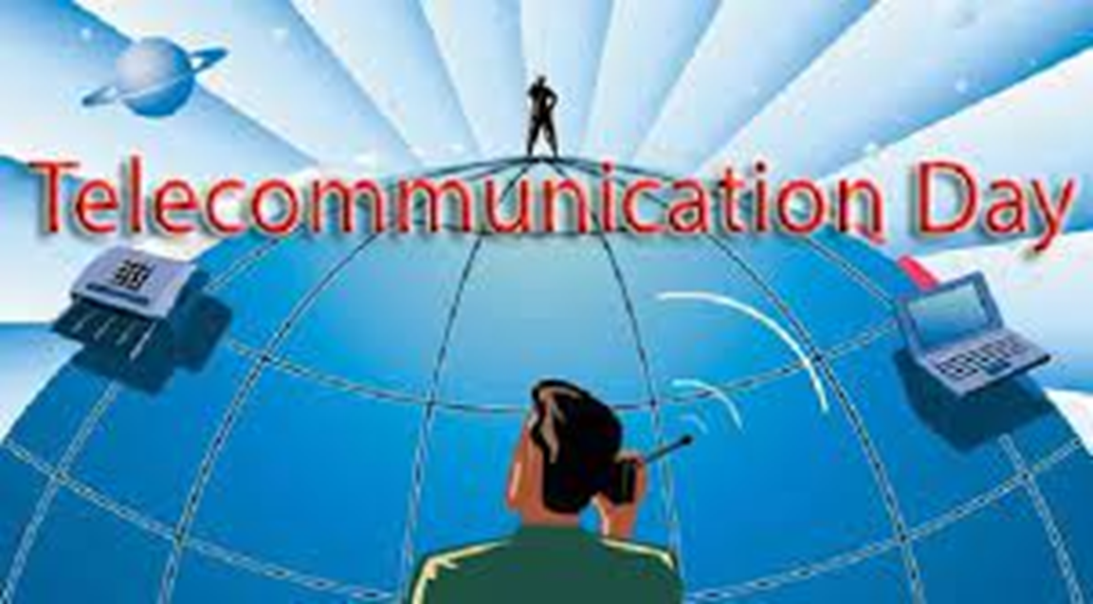
TELECOMMUNATION DAY

Slide 2
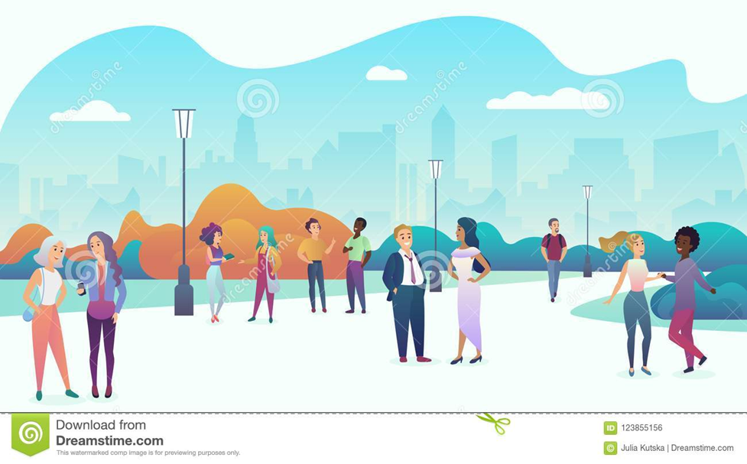
Every year on May 17 World Telecommunication and Information Day is celebrated. The pandemic (covid-19) has highlighted the importance of technology and telecommunication as most classes were online. Telecommunications are important to people as in this way we can communicate effectively.

