Slide 1
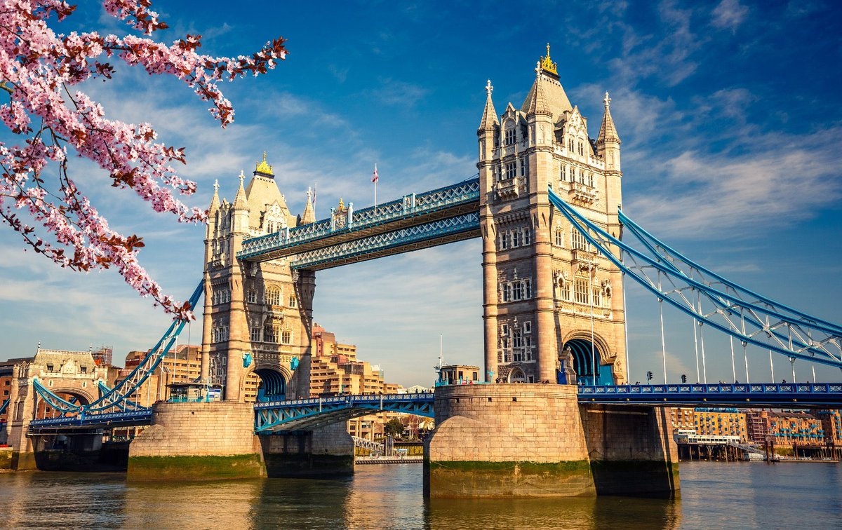
London’s Tower Bridge

Slide 2
London’s Tower Bridge
Tower Bridge is London’s most famous bridge.
The bridge crosses the River Thames close to the Tower of London and has become a world-
famous symbol of the city.

Slide 3
Architecture
Thanks to its New-Gothic architecture and lifting central sections it’s London’s most striking and sophisticated bridge.
Sir Horace Jones is the architect behind Tower Bridge.
It was built between 1886 and 1894.
It Took 432 construction workers eight years to build the Tower Bridge.

Slide 4
Fun Facts About The Bridge
It only takes five minutes to raise the bridge.
It’s used by 40,000 people per day.
The bridge was built to look in keeping with its much older neighbour, The Tower of London.

