Slide 1
School Objects!
by Chrysa Babana

Slide 2
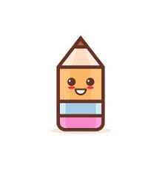
Pencil
A pencil is an implement for writing or drawing, constructed of a narrow, solid pigment core in a protective casing that prevents the core from being broken or marking the user's hand.

Slide 3
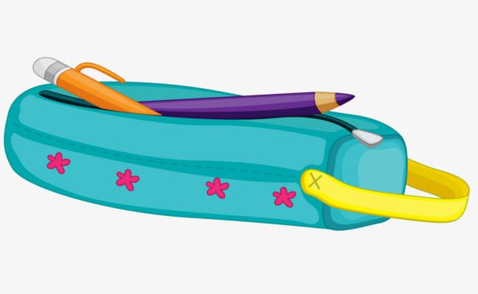
Pencil Case
A pencil case or pencil box is a container used to store pencils. A pencil case can also contain a variety of other stationery such as sharpeners, pens, glue sticks, erasers, scissors, rulers and calculators.

Slide 4
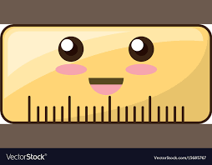
Ruler
A ruler is a device used in geometry and technical drawing, as well as the engineering and construction industries, to measure distances or draw straight lines.

Slide 5
Eraser
An eraser is an article of stationery that is used for removing marks from paper or skin erasers have a rubbery consistency and come in a variety of shapes, sizes and colors.

Slide 6
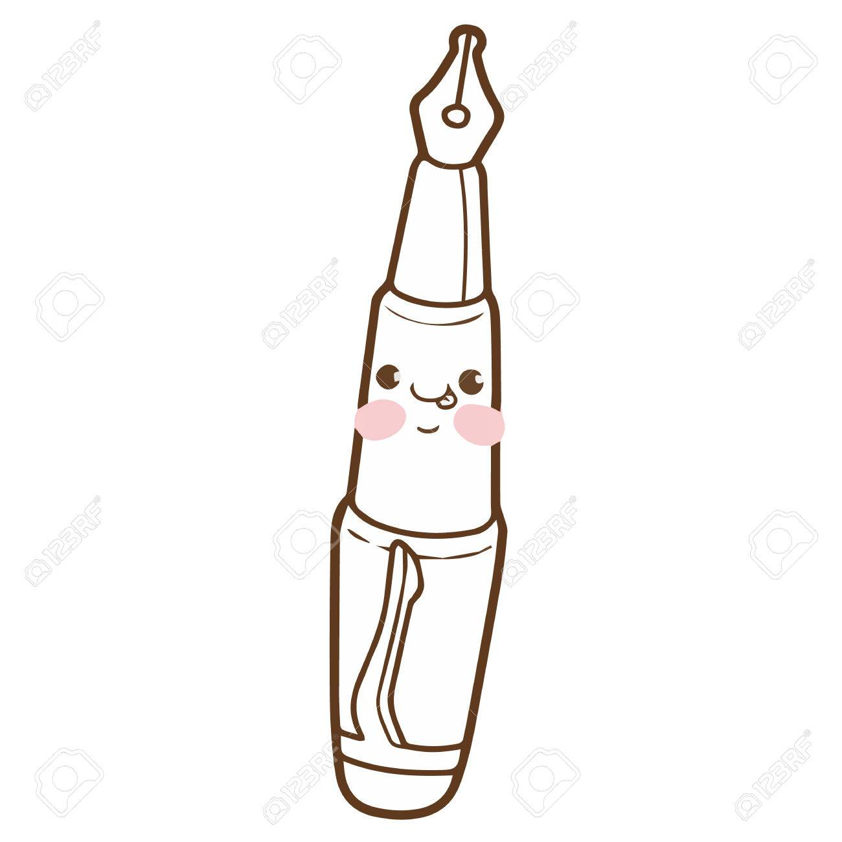
Pen
A pen is a common writing instrument used to apply ink to a surface, usually paper, for writing or drawing.

Slide 7
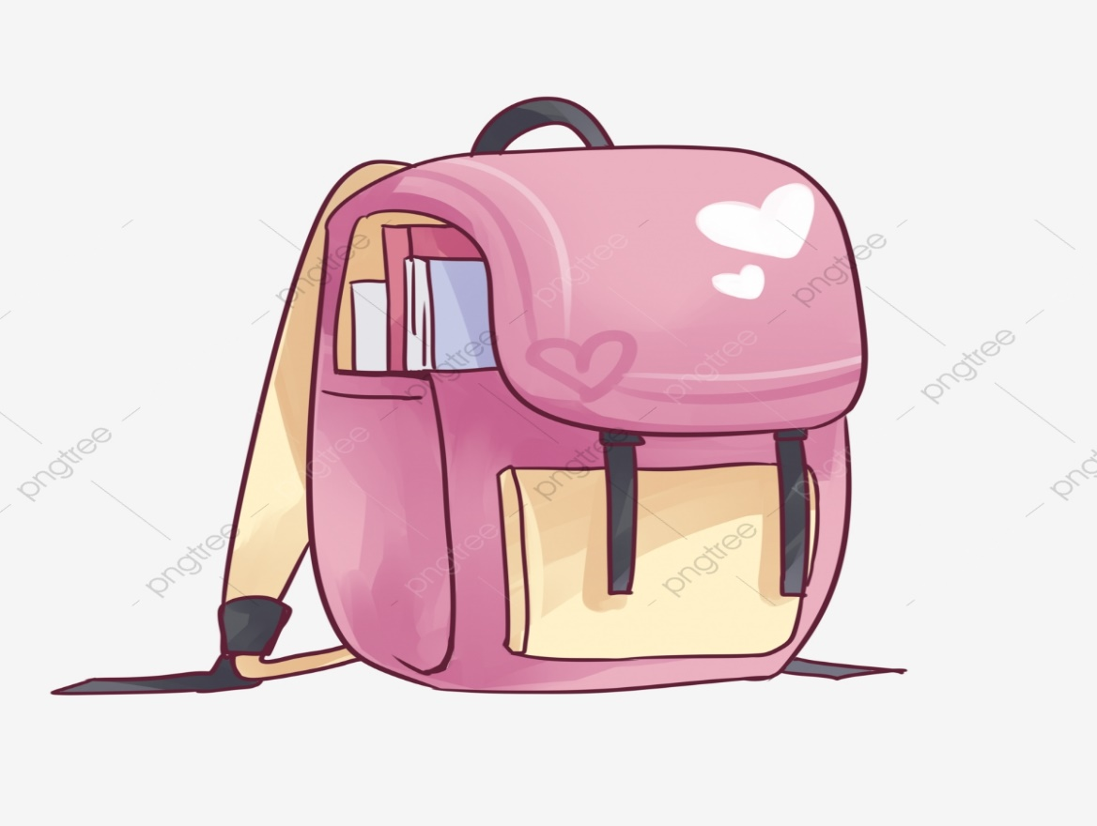
Schoolbag
A schoolbag is a cloth sack carried on one's back and secured with two straps that go over the shoulders, but it can also have an external frame, internal frame.

Slide 8
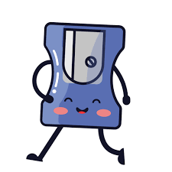
Sharpener
A sharpener is an implement for sharpening.

Slide 9
Scissors
Scissors are hand-operated shearing tools. A pair of scissors consists of a pair of metal blades pivoted so that the sharpened edges slide against each other when the handles (bows) opposite to the pivot are closed. Scissors are used for cutting various thin materials, such as paper, cardboard, metal foil, cloth, rope, and wire.

Slide 10
Thank you!

