Slide 1
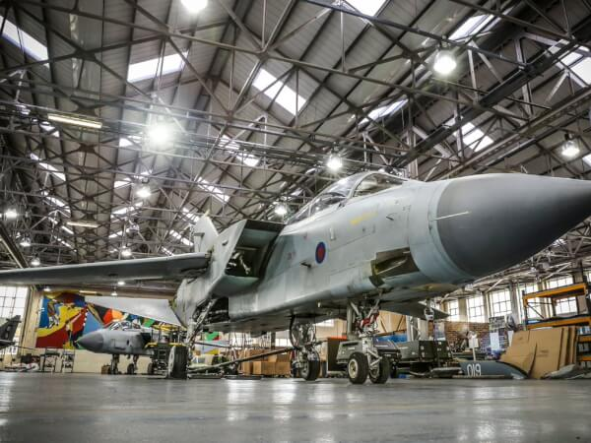
Royal Air Force Museum London
The Royal Air Force Museum London (also commonly known as the RAF Museum) is located on the former Hendon Aerodrome. It includes five buildings and hangars showing the history of aviation and the Royal Air Force.

Slide 2
The F-4 Phantom II is a two-seat, twin-engine, all-weather, long-range jet interceptor and fighter-bomber. It is my favorite plane. I want to be a pilot and fly one of these in the Hellenic air force.

Slide 3
The F-35 Lightning II is an American family of single-seat, single-engine, all-weather stealth combat aircraft that is intended to perform both air superiority and strike missions.

Slide 4
The Harrier, informally referred to as the Harrier Jump Jet, is a family of jet-powered attack aircraft capable of vertical/short takeoff and landing operations.

Slide 5
The Spitfire is a British one-seat fighter aircraft that was used by the Royal Air Force and other Allied countries before, during, and after World War II. Greece had this airplane during the war. It’s a legendary airplane.
Thank you.

