Slide 1
Healthy VS Unhealthy food
by Chrysa Babana

Slide 2
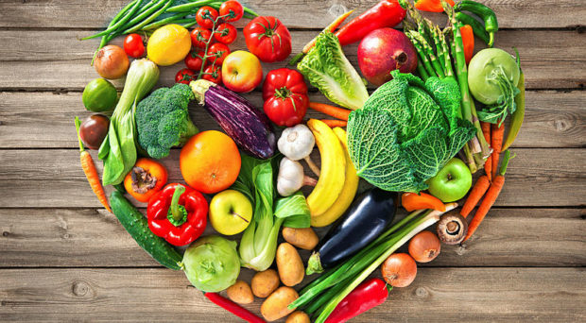
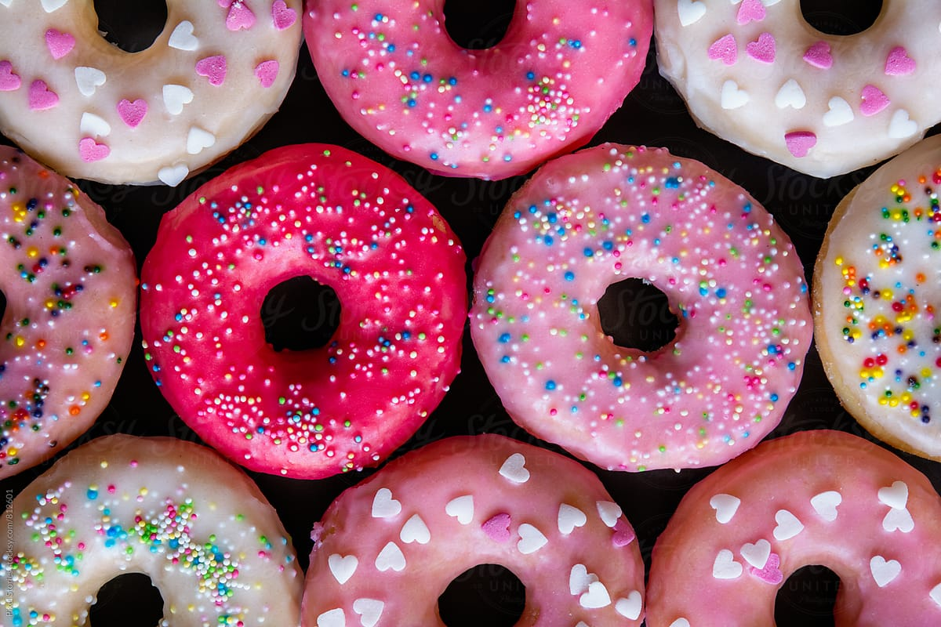
Healthy and Unhealthy food
• Healthy food • Unhealthy food

Slide 3
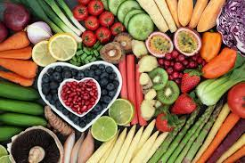
Healthy food
Healthy food is very good for us because:
It gives us energy.
It keeps us from getting sick.
It makes our bones strong.
It helps us grow.
Healthy food:
Apples
Pears
Bananas
Milk
Fish
Olive oil
Cheese
Eggs

Slide 4
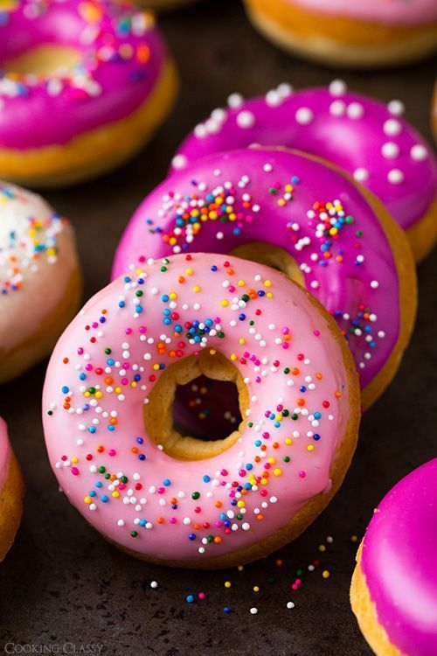
Unhealthy food
Unhealthy food is not good for us because:
• It has lots of fat, sugar and calories.
• It makes us fat.
• It makes our teeth bad.
• It doesn’t give us energy.
• Unhealthy food:
Chips
Donuts
Lollipops
Candies
Chocolate
Chewing gums
Sweets
Ice cream

Slide 5
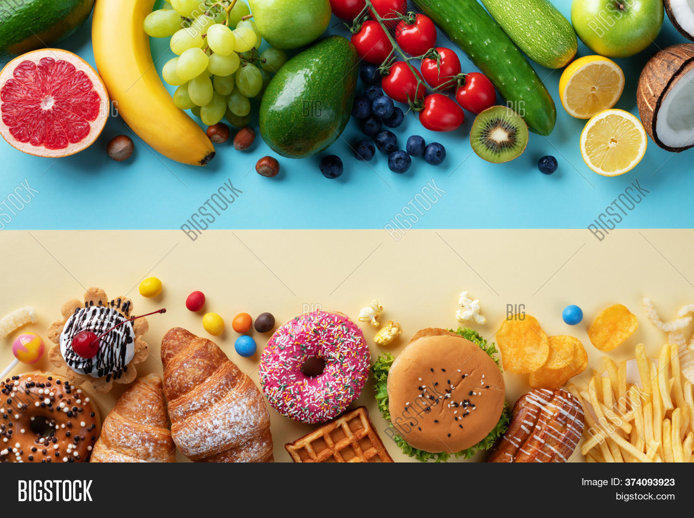
Healthy food is better than the Unhealthy food!

Slide 6
Thank you!

