Slide 1
London sightseeing!
by Chrysa Babana

Slide 2
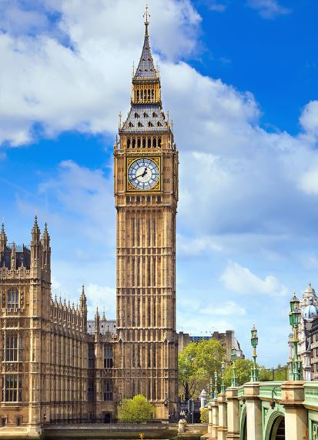
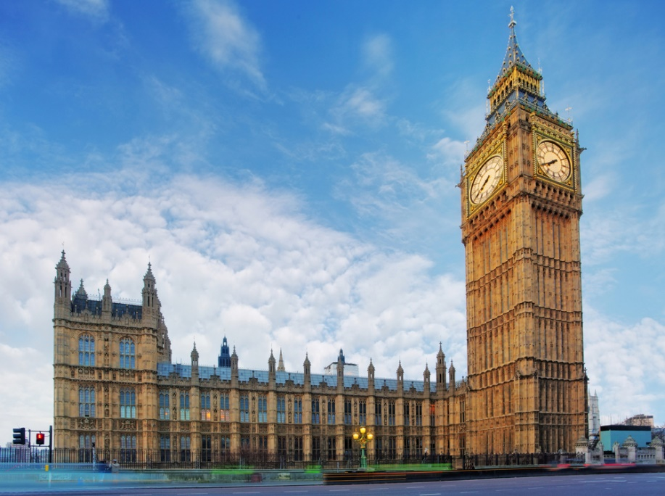
Big Ben
Big Ben is the nickname for the Great Bell of the striking clock at the Palace of Westminster and it refers to both the clock and the clock tower.

Slide 3
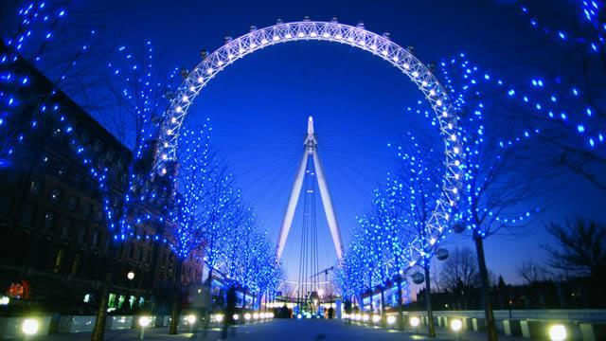
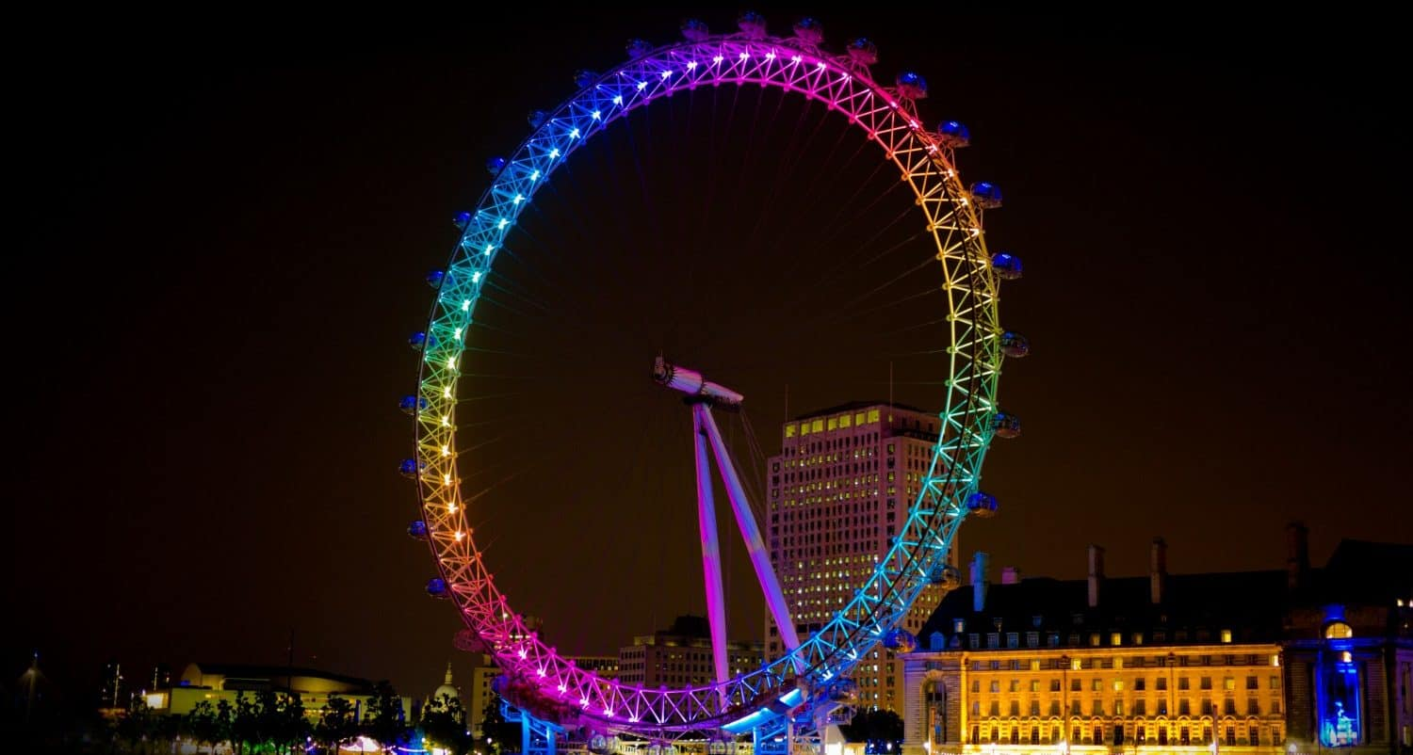
London Eye
The London Eye, or the Millennium Wheel, is an observation wheel on the South Bank of the River Thames in London. It is Europe's tallest observation wheel, and it is the most popular paid tourist attraction in the United Kingdom with over 3 million visitors annually.

Slide 4
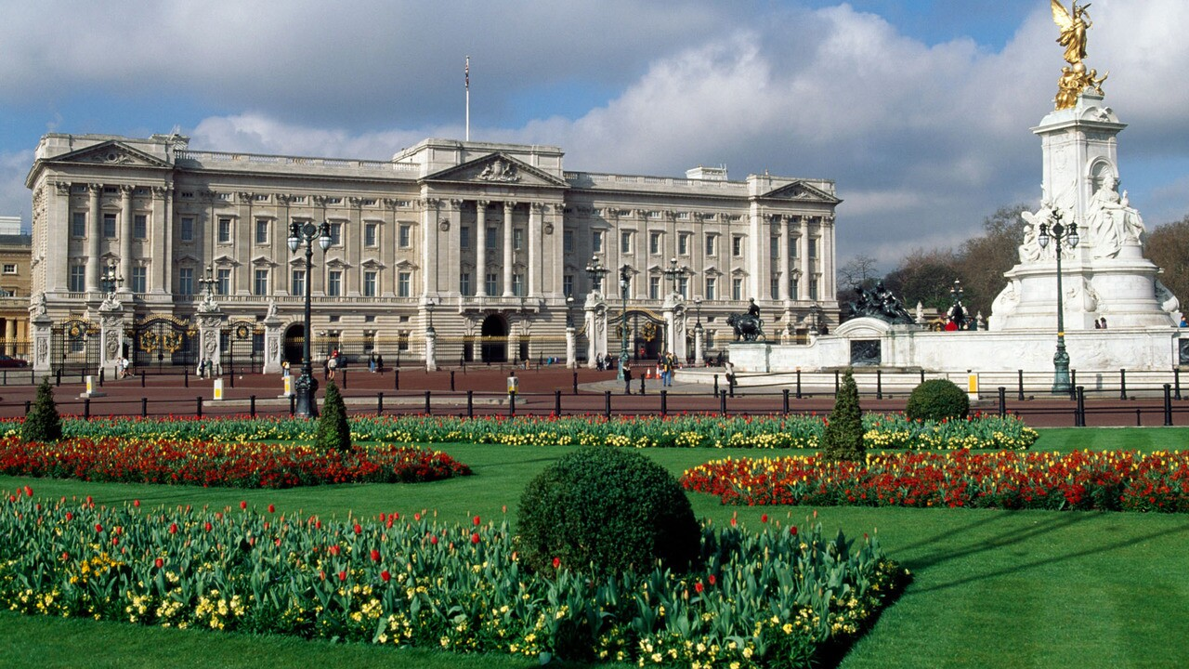
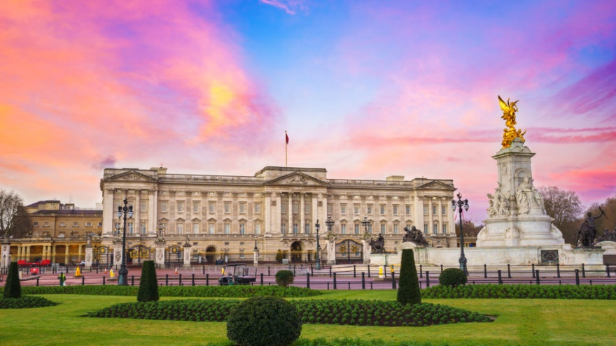
Buckingham Palace
The Buckingham Palace is the London residence of the Queen of the United Kingdom. It is located in the City of Westminster.

Slide 5
Thank you!
You must go to London and see the Buckingham Palace, the London Eye and for sure the Big Ben!

