Slide 1
Healthy and Unhealthy food
By Maria Tsigri

Slide 2
Healthy food Vs Unhealthy food
Healthy Food
Junk Food

Slide 3
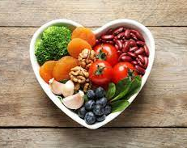
HEALTHY FOOD
Healthy food is important! A lot of people are avoiding healthy food and they eat only unhealthy food !! That’s so bad for their health. Actually when you eat more healthy food than unhealthy you can be able to live longer and it helps your brain think. People need more healthy food than unhealthy food.

Slide 4
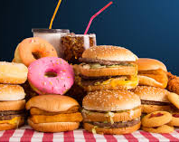
UNHEALTHY FOOD
Unhealthy food is not necessary for your body and health. If you don’t want to be healthy and you also want to be fat junk food is the best solution to your problem.

Slide 5
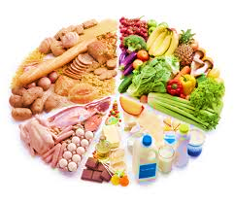
Food Pyramid
The Food Pyramid is something that can help you to eat healthy. In the top of the pyramid there are some things that you shouldn’t eat often, these are sugar, cake, candy and more unhealthy stuff just like junk food. In the second level we got dairy products such us meat, fish, eggs. In the third level of our pyramid we got vegetable and fruit these are the best for you to eat if you want to be full and at the same time healthy. At the bottom of the pyramid we have grains and bread we also have potatoes which belong to that category because they can give you carbohydrates. In reality they belong to the category of the vegetables.

Slide 6
💗The End💗

