Slide 1
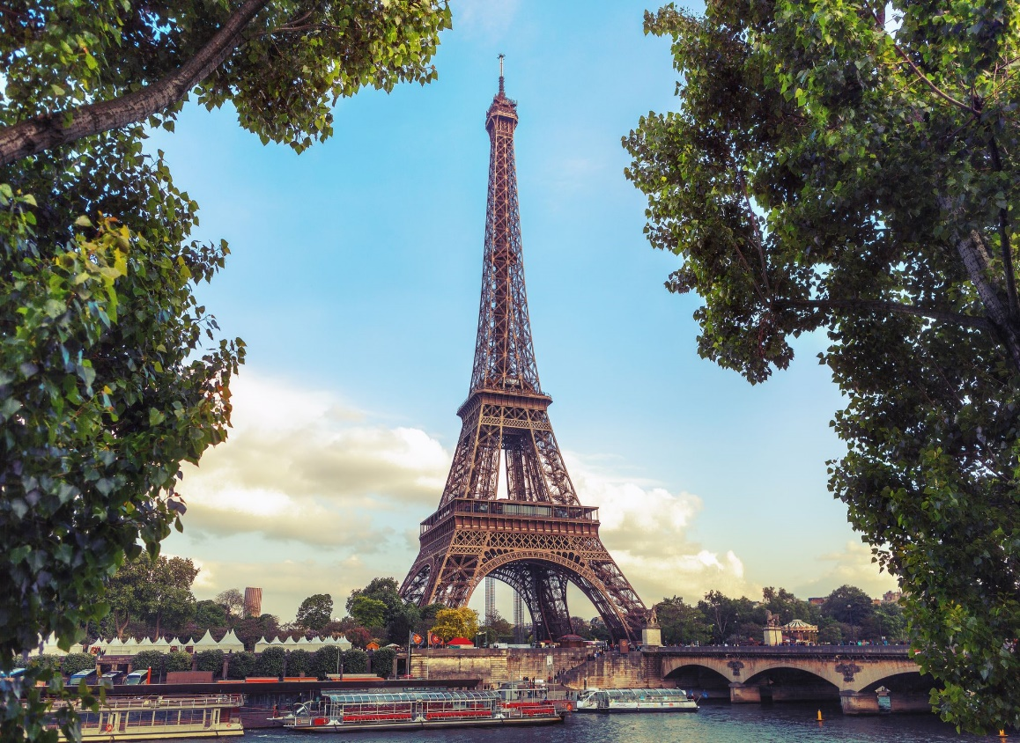
The Eiffel Tower
The symbol of PARIS
Παρουσίαση: Στράτος Μάρκος

Slide 2
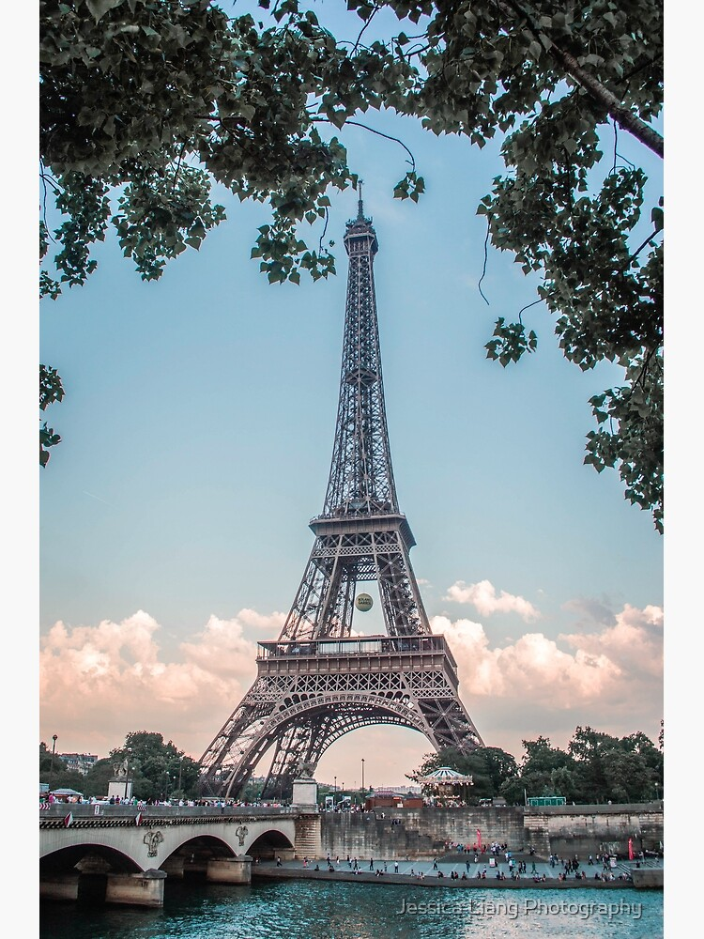
The Eiffel Tower is one of the most famous buildings in the world. Is the symbol of Paris, France.

Slide 3
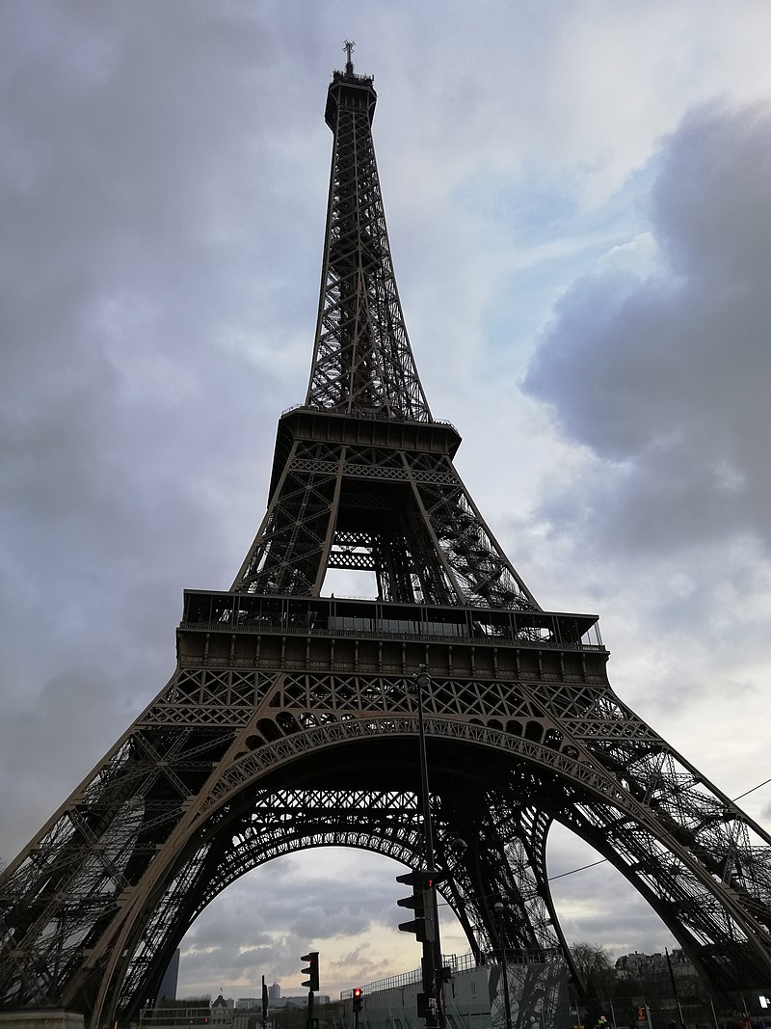
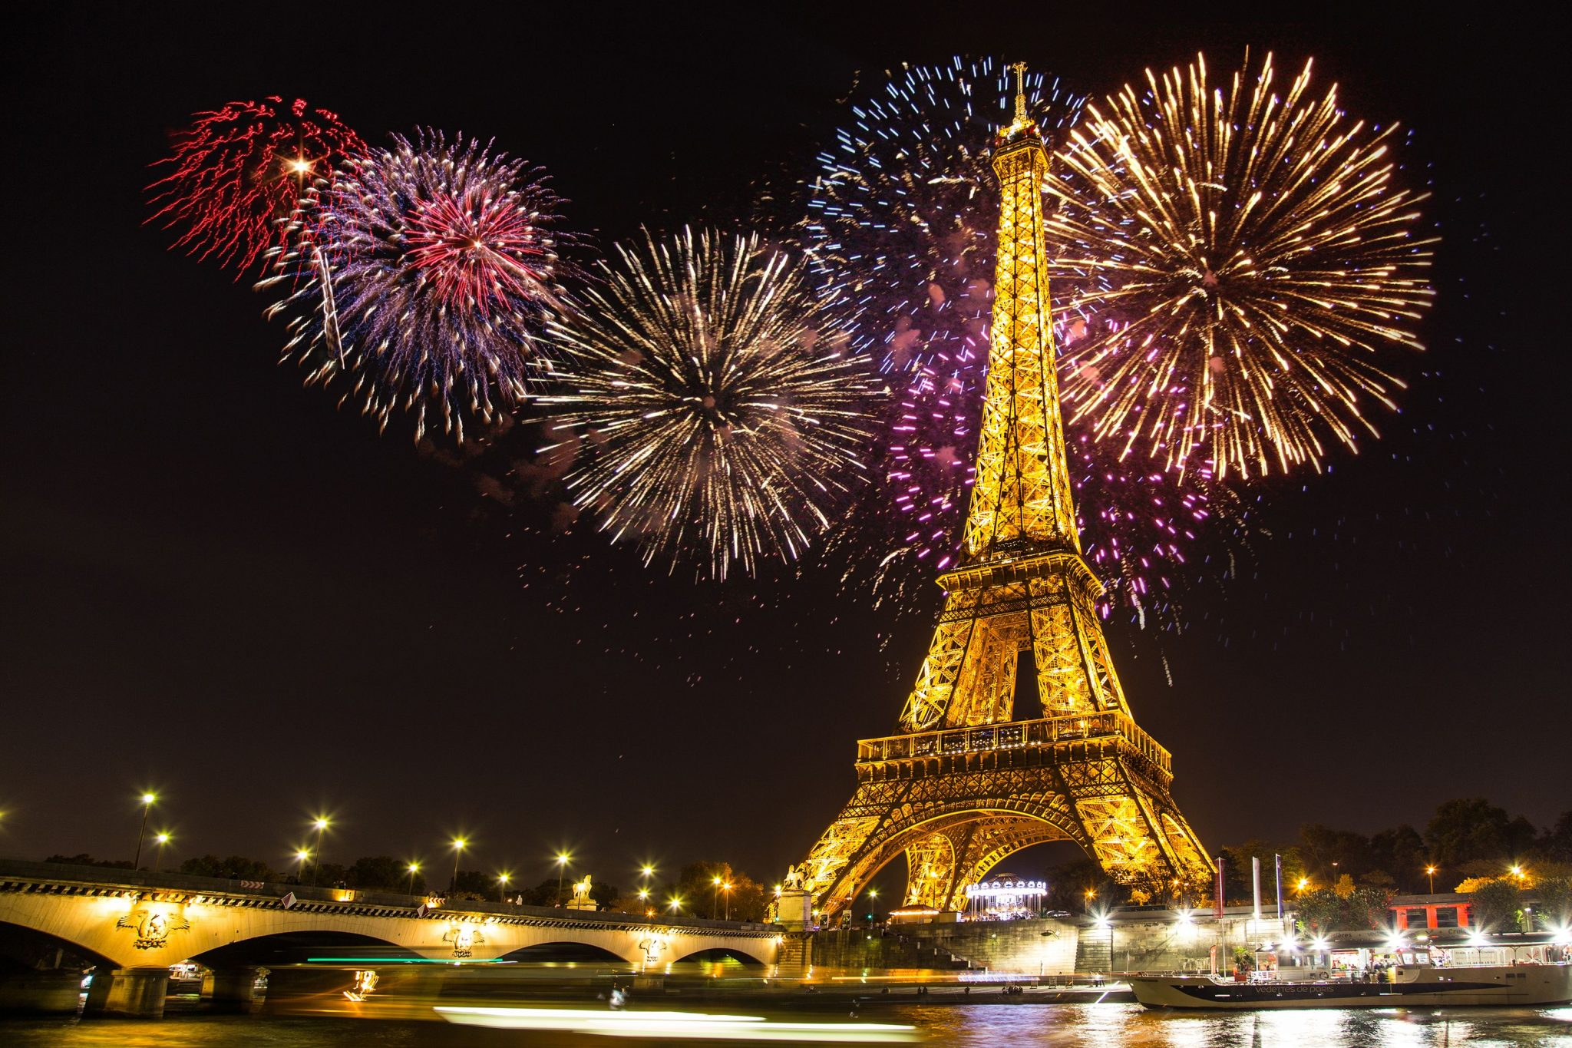
It was built in 1889 by Gustavo Eiffel. It’s 324 meters high and is made of iron. Millions of people from all over the world visit it every year.

