Slide 1
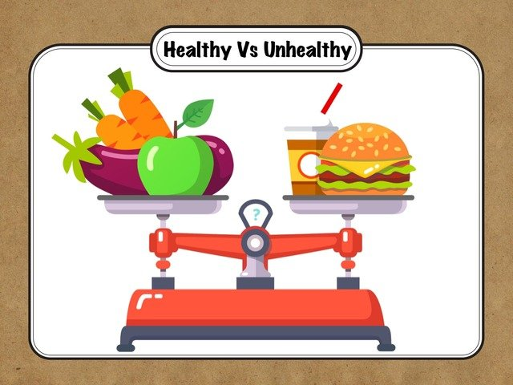
Healthy and Unhealthy Food

Slide 2
Healthy Food Options:
Vegetables and fruits
Eggs
Fish
Lean meat
Beans and legumes
Avocados
Olive oil
Nuts
Oats, brown rice and quinoa
Yogurt

Slide 3
What healthy food gives us:
Heart Health
Strong bones and teeth
Better mood and energy levels
Improved memory and brain health
Weight loss

Slide 4
Unhealthy Food
Sugary drinks
Sweetened breakfast cereals
Fried food
French fries and potato chips
Donuts
Bacon and sausages
Fast food meals
Cookies and cakes (store bought)
Salt

Slide 5
How unhealthy food affects us:
Tooth decay
Heart disease
High blood pressure
Depression
Weight gain

Slide 6
Conclusion:
Eating healthy is essential for good health and nutrition. <3
Thank you all for your attention!

