Slide 1

Netiquette
Polite behavior online for the Young

Slide 2

Netiquette
: (Net + etiquette) is a set of rules for nice behavior when we communicate online.

Slide 3
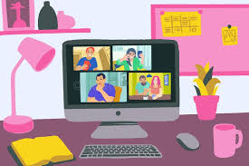


. Time spent online must be fun and safe.

Slide 4

Respect and Dignity
Treat everyone online the way you want to be treated.

Slide 5
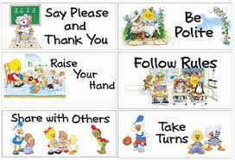
Here are some ways to show respect- At school

Slide 6
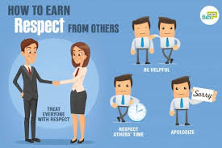
Here are some ways to show respect- At work

Slide 7


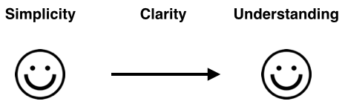

Make yourselves clear when you use Internet.

Slide 8
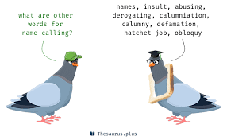

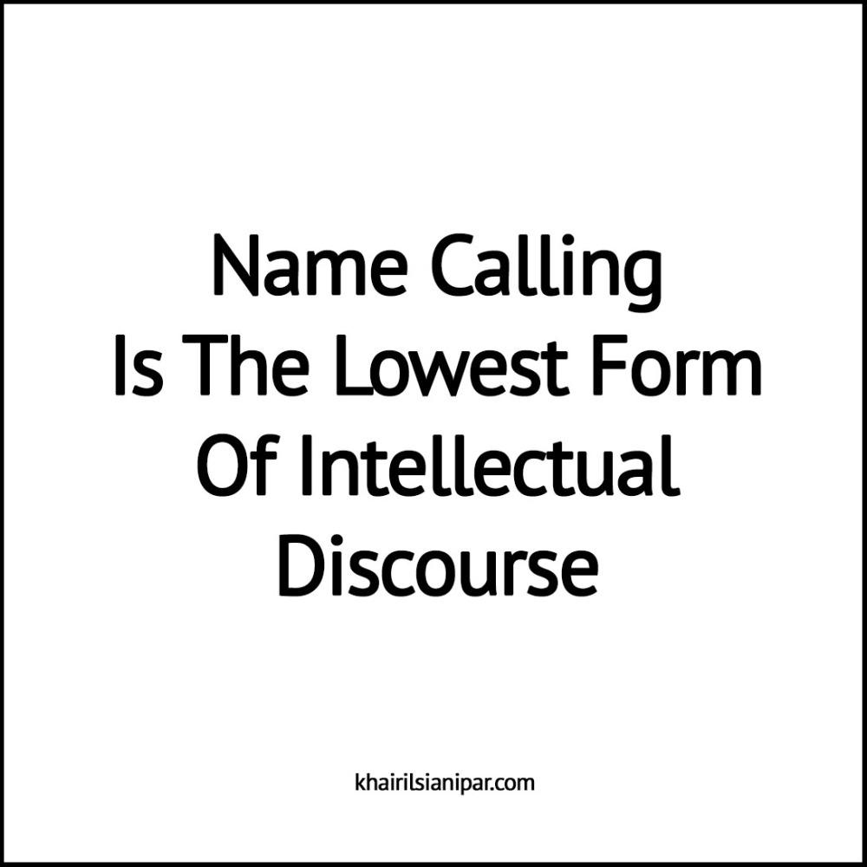

Politeness and Posting

Slide 9

https://wordart.com/create wordart

Slide 10
References-sources
https://www.amazon.com/Argus-Respect-Treating-others-Poster-13-375/dp/B000OQJ1TQ
https://www.google.com/url?sa=i&url=https%3A%2F%2Fstlpolished.com%2Fseven-must-know-netiquette-rules-for-professional-behavior%2F&psig=AOvVaw115gMHd6L0_RTl1luYiXQO&ust=1590412848673000&source=images&cd=vfe&ved=0CAIQjRxqFwoTCKDG8N7LzOkCFQAAAAAdAAAAABAE
https://www.google.com/imgres?imgurl=https%3A%2F%2Fthumbs.dreamstime.com%2Fb%2Fchatting-friends-family-online-virtual-party-meet-up-video-conference-stay-home-safe-people-meeting-together-have-fun-180836053.jpg&imgrefurl=https%3A%2F%2Fwww.dreamstime.com%2Fillustration%2Fvideo-conference-zoom.html&tbnid=yM37WtWtaNWP7M&vet=10CEUQMyghahcKEwiI3676zczpAhUAAAAAHQAAAAAQBA..i&docid=5PO1f6GH-wcKDM&w=800&h=533&itg=1&q=friends%20having%20fun%20nline%20and%20safe&ved=0CEUQMyghahcKEwiI3676zczpAhUAAAAAHQAAAAAQBA
https://www.amazon.com/Argus-Respect-Treating-others-Poster-13-375/dp/B000OQJ1TQ
https://www.google.com/url?sa=i&url=https%3A%2F%2Fclipartart.com%2Fcategories%2Fkids-showing-respect-clipart.html&psig=AOvVaw26ob6kfXoYe07y5mkSMehv&ust=1590404987256000&source=images&cd=vfe&ved=2ahUKEwjJw-SzrszpAhUHghoKHQkxAfcQr4kDegUIARDWAQ
https://www.google.com/imgres?imgurl=https%3A%2F%2Fusercontent2.hubstatic.com%2F13954823_f496.jpg&imgrefurl=https%3A%2F%2Fhubpages.com%2Frelationships%2FLet-Love-Define-You&tbnid=zaOs194LM4SN-M&vet=10CK0BEDMoUWoXChMI-M3_1K7M6QIVAAAAAB0AAAA
https://wordart.com/create
https://www.google.com/url?sa=i&url=http%3A%2F%2Fkiwimadepreaching.com%2F2017%2F10%2Fthe-pursuit-of-clarity-jonathan-robinson%2F&psig=AOvVaw22CsnZYI0Pn3xH0UDlUObm&ust=1590407238987000&source=images&cd=vfe&ved=0CAIQjRxqFwoTCLitwfe2zOkCFQAAAAAdAAAAABBc
http%3A%2F%2Fkiwimadepreaching.com%2F2017%2F10%2Fthe-pursuit-of-clarity-jonathan-robinson%2F&psig=AOvVaw22CsnZYI0Pn3xH0UDlUObm&ust=1590407238987000&source=images&cd=vfe&ved=0CAIQjRxqFwoTCLitwfe2zOkCFQAAAAAdAAAAABBc
https://www.google.com/url?sa=i&url=https%3A%2F%2Frevealedresources.com%2Fhow-to-answer-what-do-you-do-the-right-way%2Fclarity-of-message%2F&psig=AOvVaw22CsnZYI0Pn3xH0UDlUObm&ust=1590407238987000&source=images&cd=vfe&ved=0CAIQjRxqFwoTCLitwfe2zOkCFQAAAAAdAAAAABBC
https://www.google.com/url?sa=i&url=http%3A%2F%2Fkiwimadepreaching.com%2F2017%2F10%2Fthe-pursuit-of-clarity-jonathan-robinson%2F&psig=AOvVaw22CsnZYI0Pn3xH0UDlUObm&ust=1590407238987000&source=images&cd=vfe&ved=0CAIQjRxqFwoTCLitwfe2zOkCFQAAAAAdAAAAABBchttps://www.google.com/url?sa=i&url=
https%3A%2F%2Flucilleossai.com%2Fblog%2F2017%2F11%2F29%2Fthe-case-for-clarity-in-business-communication%2F&psig=AOvVaw22CsnZYI0Pn3xH0UDlUObm&ust=1590407238987000&source=images&cd=vfe&ved=0CAIQjRxqGAoTCLitwfe2zOkCFQAAAAAdAAAAABDHAQ
https://www.google.com/url?sa=i&url=https%3A%2F%2Fmeghillman.wordpress.com%2F2016%2F11%2F13%2Falways-say-please-and-thank-you%2F&psig=AOvVaw188sJ4ex2PdGcFEgBNZqhd&ust=1590408587922000&source=images&cd=vfe&ved=0CAIQjRxqFwoTCOD08PS7zOkCFQAAAAAdAAAAABAD
https://www.google.com/url?sa=i&url=https%3A%2F%2Fkhairilsianipar.wordpress.com%2F2017%2F06%2F10%2Fsdr-1234-name-calling-is-the-lowest-form-of-intellectual-discourse%2F&psig=AOvVaw1JvI24aeH9EnBAxIn36ToX&ust=1590408741408000&source=images&cd=vfe&ved=0CAIQjRxqGAoTCJCm7s-8zOkCFQAAAAAdAAAAABDCAQhttps://www.google.com/url?sa=i&url=https%3A%2F%2Fthesaurus.plus%2Fsynonyms%2Fname_calling&psig=AOvVaw1JvI24aeH9EnBAxIn36ToX&ust=1590408741408000&source=images&cd=vfe&ved=0CAIQjRxqGAoTCJCm7s-8zOkCFQAAAAAdAAAAABCJAghttps://www.google.com/url?sa=i&url=
https%3A%2F%2Fwww.suziecheel.com%2Fbeach-inspiration-be-forgiving-to-be-fabulous%2F&psig=AOvVaw2bQlc4g-T4QSPiwd0oNPpk&ust=1590409836590000&source=images&cd=vfe&ved=0CAIQjRxqFwoTCKCcssXAzOkCFQAAAAAdAAAAABAN

Slide 11

Thank you for watching

