Slide 1
My daily routine before COVID19
I used to wake up at 07:00
I used to get up from bed immediately
I used to eat my breakfast quickly
I used to brush my teeth fast
Now I wake up at 09:00
Now I stay in bed for a while and watch TV
Now I eat my breakfast slowly
Now I brush my teeth carefully
I used to comb my hair
I used to get dressed
I used to go to school
Now I do not need to comb my hair
Now sometimes I wear my Pajamas all day
Now I do not go to school

Slide 2
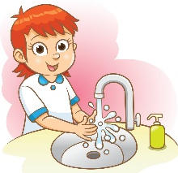
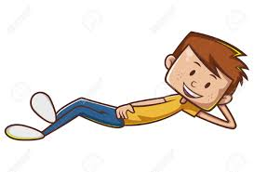
My daily routine before COVID19
I used to take classes at school
I used to have a snack at school
I used to play with my friends at the breaks
Now I take online classes at home
Now I usually forget to have a snack
Now I cannot play with my friends
I used to wash my hands and
change my clothes
I used to return home
I used to eat lunch quickly
I used to relax for an hour
Now I do not leave the house everyday
Now I constantly wash my hands
and change clothes whenever
I return home
Now I eat lunch and watch TV for half an hour
Now I do not need to relax

Slide 3
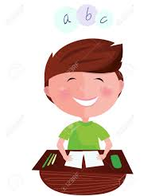
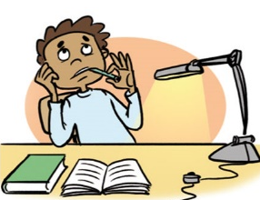
My daily routine before COVID19
I used to do my homework
I used to exercise 3 times a week
I used to have English lessons
Now I do not have so much homework
Now I exercise daily in and outside the house
Now I cannot have English lessons at home
I used to eat dinner at 20:30
I used to take a quick shower
I used to brush my teeth
I used to go to bed at 21:30
Now I eat dinner at 21:30
Now I take a long shower
Now I brush my teeth for 2’
Now I go to bed late

