Slide 1
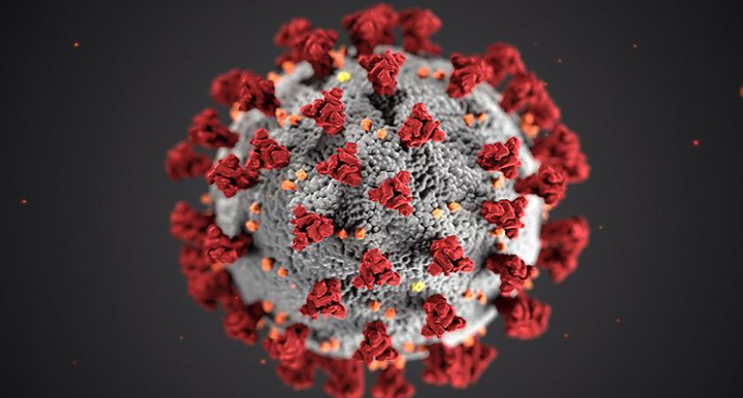
How can we protect ourselves from the Covid-19?

Slide 2
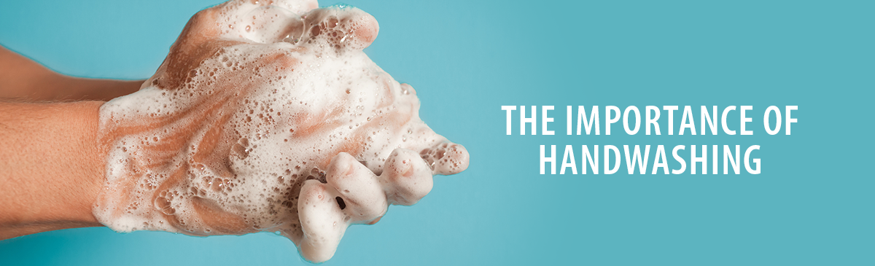
Wash your hands
Wash your hands often with soap and water for at least 20 seconds especially after you have been in a public place, or after blowing your nose, coughing, or sneezing.
If you don’t have soap and water, use a hand sanitizer that contains at least 60% alcohol.
Don’t touch your eyes, nose, and mouth with unwashed hands.

Slide 3
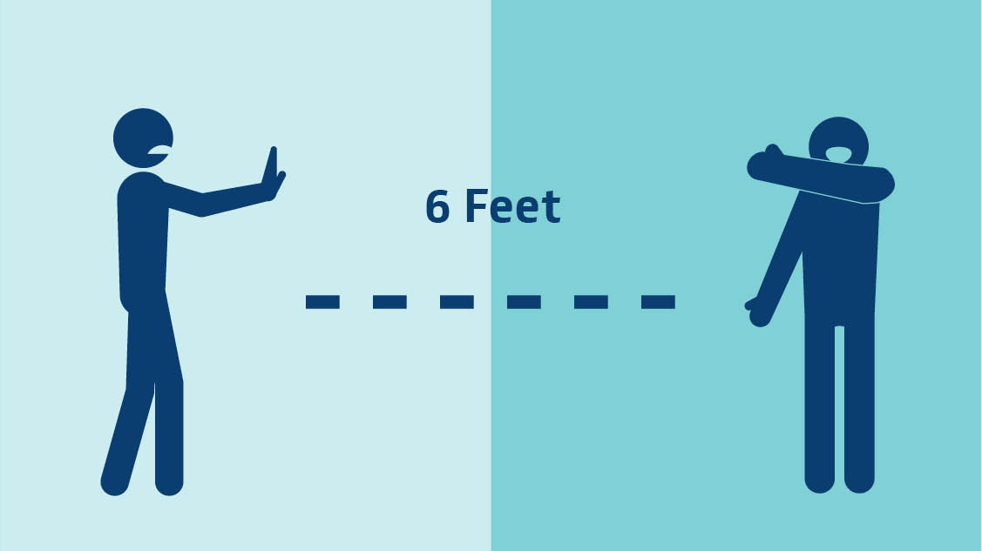
Don’t be close with other persons
Avoid close contact
Avoid close contact with people who are sick, even inside your home. If possible, maintain 6 feet between the person who is sick and other household members.
Put distance between yourself and other people outside of your home.
Remember that some people without symptoms may be able to spread virus.
Stay at least 6 feet (about 2 arms’ length) from other people.
Do not gather in groups.
Stay out of crowded places and avoid mass gatherings.
Keeping distance from others is especially important for people who are at higher risk of getting very sick.

Slide 4
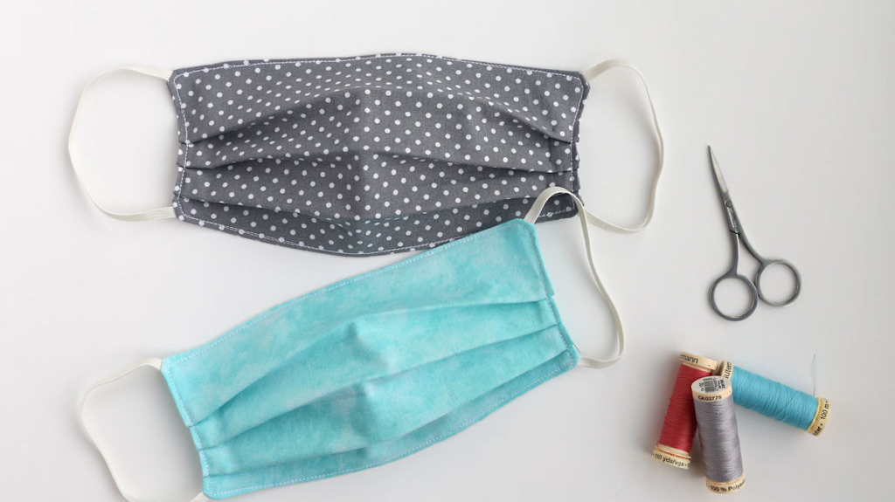
Cover your mouth and nose with a cloth face cover when around others.
You could spread COVID-19 to others even if you do not feel sick.
Everyone should wear a cloth face cover when they have to go out in public, for example to the grocery store or to pick up other necessities.
Cloth face coverings should not be placed on young children under age 2, anyone who has trouble breathing, or is unconscious, incapacitated or otherwise unable to remove the mask without assistance.
The cloth face cover is meant to protect other people in case you are infected.
Do NOT use a facemask meant for a healthcare worker.
Continue to keep about 6 feet between yourself and others. The cloth face cover is not a substitute for social distancing.

Slide 5
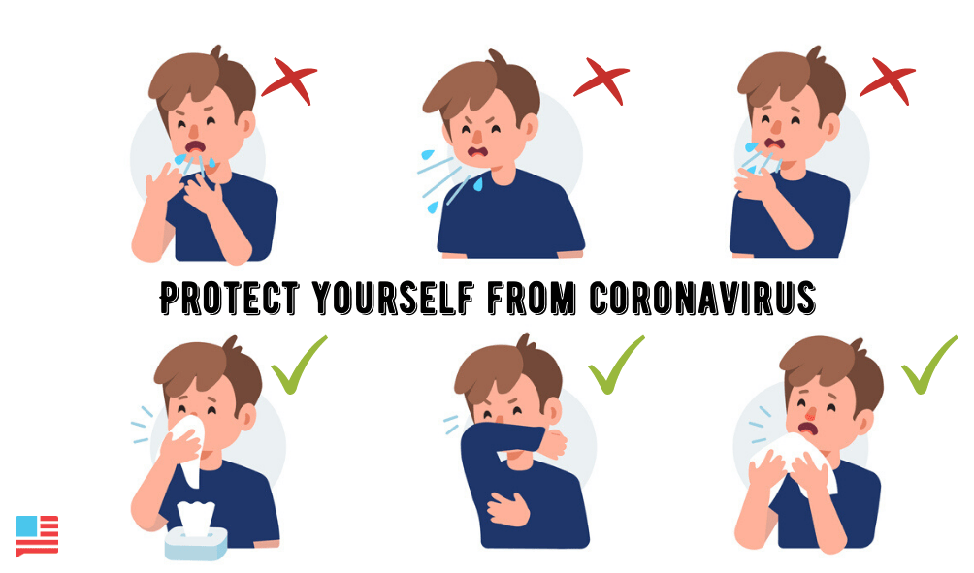
Cover coughs and sneezes
If you are in a private setting and do not have on your cloth face covering, remember to always cover your mouth and nose with a tissue when you cough or sneeze or use the inside of your elbow.
Throw used tissues in the trash.

Slide 6
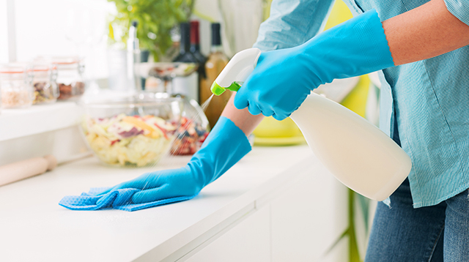
Clean and disinfect
Clean and disinfect the touched surfaces daily. This includes tables, doorknobs, light switches, countertops, handles, desks, phones, keyboards, toilets, faucets, and sinks.
If surfaces are dirty, clean them. Use detergent or soap and water prior to disinfection.

Slide 7
And this is how you will protect your selve from Covid-19 Evelyn

