Slide 1
Covid 19
How can we protect from

Slide 2

1. Wash your hands…
Everyone knows that all the virouses «hate» soap. Same with Covid 19. If you wash your hands with soap and water, or with an antiseptic, Covid 19 will not stuck to you.

Slide 3

2. Keep distance…
You must keep a distance of 2 metres (6 feet). If you do that, you will not give or get the coronavirous.

Slide 4
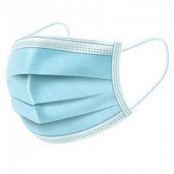
3. Use Masks...
If one Person has coronavirous , and he doesn’t show any symptoms, he must use a mask. That’s why everyone says it! If everyone wears a mask, they will not stuck or give coronavirous.

Slide 5

4.Protect the elders…
Don’t visit your grandparents. They’re in danger more than you. They mustn’t see other people for a while. It’s for their safety.

Slide 6

STAY AT HOME!

Slide 7
THANKS FOR WATCHING!
Nireas

